Slide 1
Diffusion

Slide 2
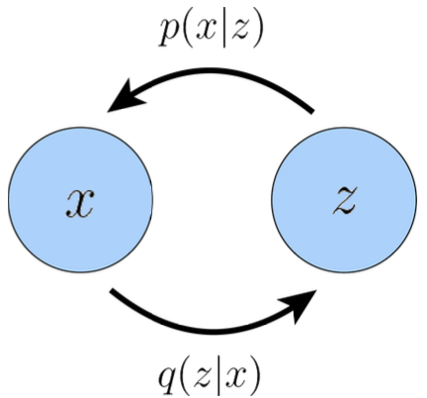
VAE
Decoder
X
Encoder
Z
Decoder
X
Encoder

Slide 3
Hierarchical VAE
Decoder
Encoder

Slide 4
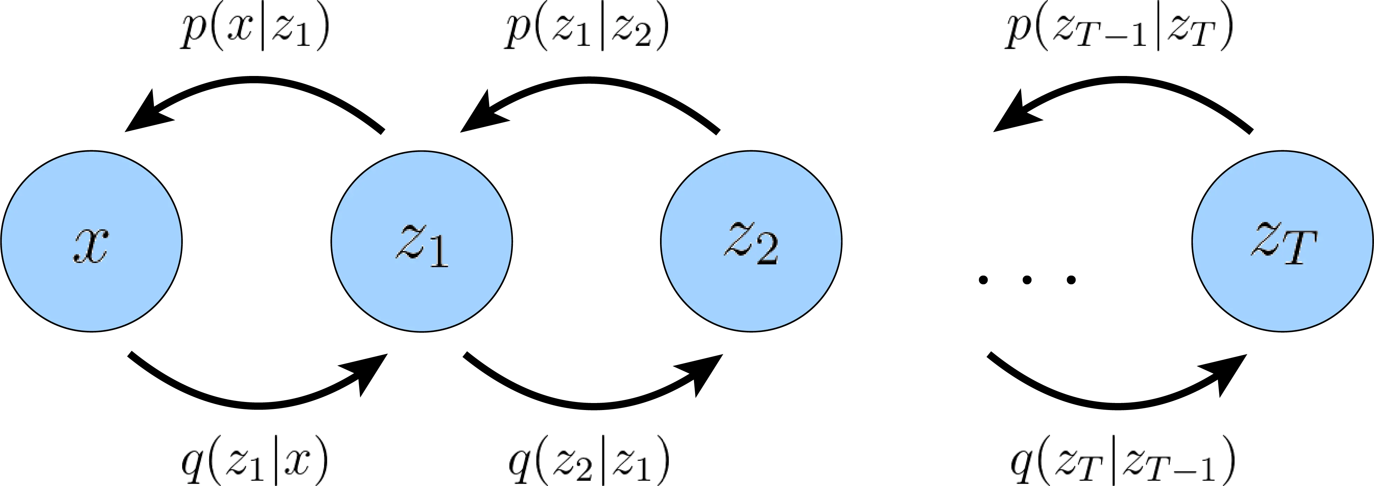
Hierarchical VAE
Decoder
Markov Decoders
Encoder
Markov Encoders

Slide 5
Hierarchical VAE
Decoder
Markov Decoders
Encoder
Markov Encoders
But unlike VAEs, we don’t want to let loose the latent space.
Instead, we want to guide the latent space to satisfy some boundary conditions. These boundary conditions should allow tractability, interpretability, better mathematical handle, etc.
Variational Diffusion Models (VDM)

Slide 6
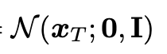
Hierarchical VAE
Decoder
Markov Decoders
Encoder
Markov Encoders
But unlike VAEs, we don’t want to let loose the latent space.
Instead, we want to guide the latent space to satisfy some boundary conditions. These boundary conditions should allow tractability, interpretability, better mathematical handle, etc.
Variational Diffusion Models (VDM)
VDMs = 3 conditions on HVAEs:
1. Latent dimension same as data
2. Encoding process is not learnt
3. The final state is white noise,

Slide 7
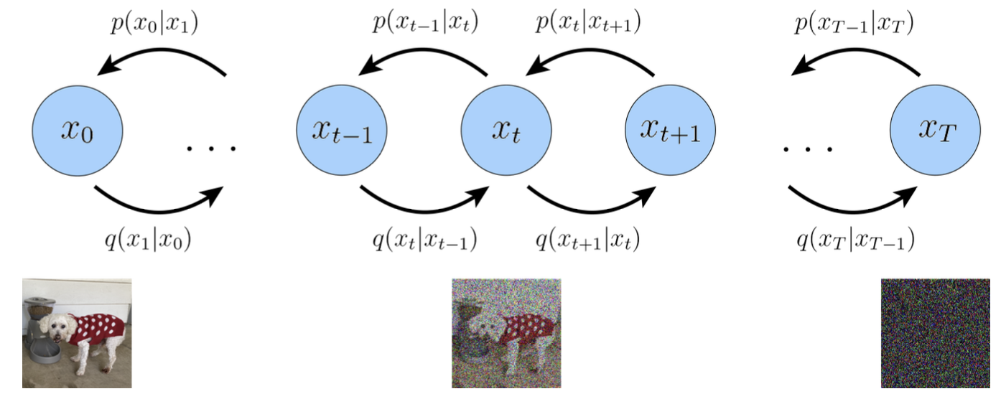
VDM
1. Latent dimension same as data
2. Encoding process is not learnt
3. The final state is white noise,

Slide 8
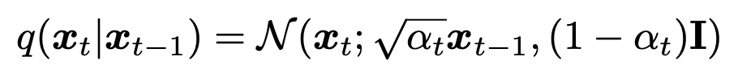
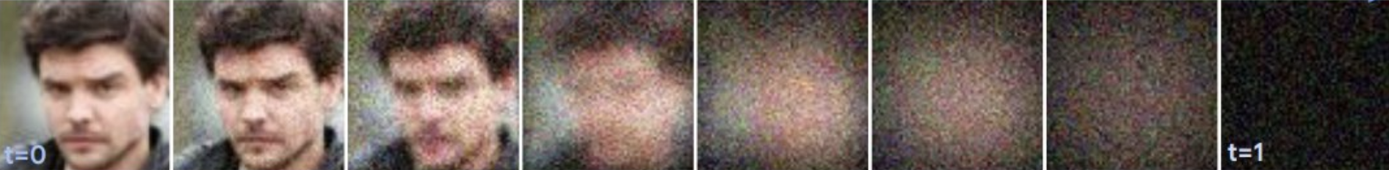
VDM
1. Latent dimension same as data
2. Encoding process is not learnt
3. The final state is white noise,
Markov Encoders = Adding Gaussian Noise step by step

Slide 9

VDM
1. Latent dimension same as data
2. Encoding process is not learnt
3. The final state is white noise,
Markov Encoders = Adding Gaussian Noise step by step

Slide 10
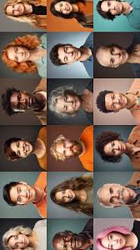
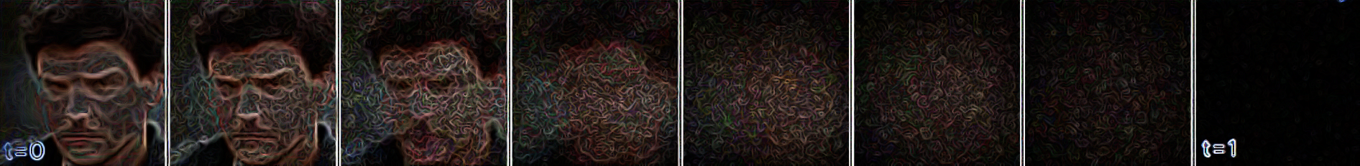
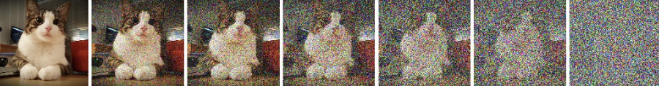
VDM
Markov Decoders = Denoising step by step to get to original
Markov Encoders = Adding Gaussian Noise step by step

Slide 11
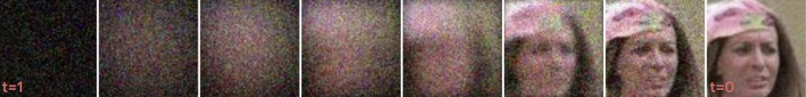
VDM
Markov Decoders = Denoising step by step to get to original
Markov Encoders = Adding Gaussian Noise step by step

Slide 12
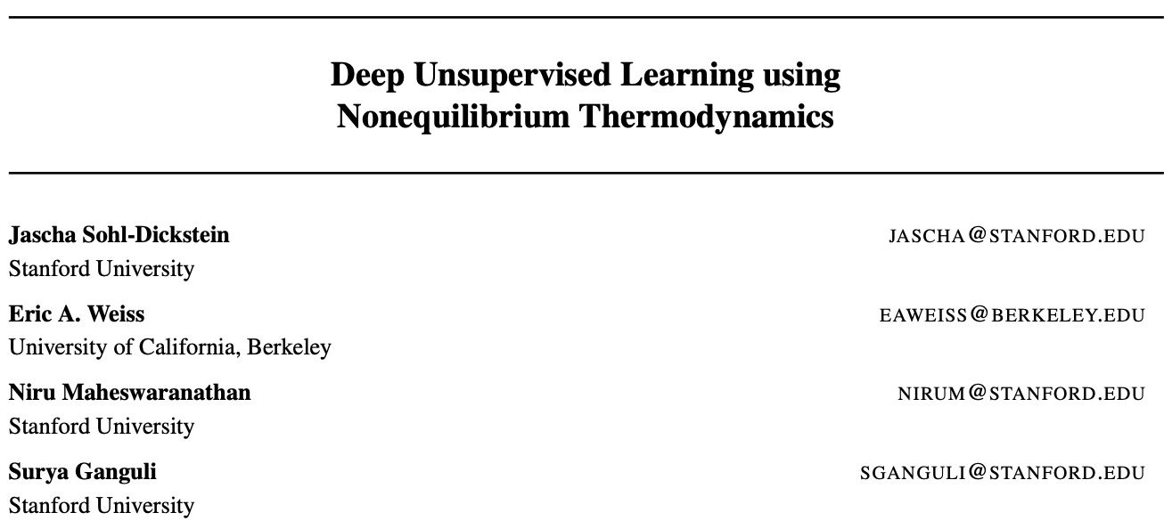
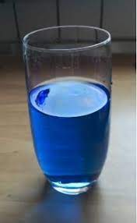
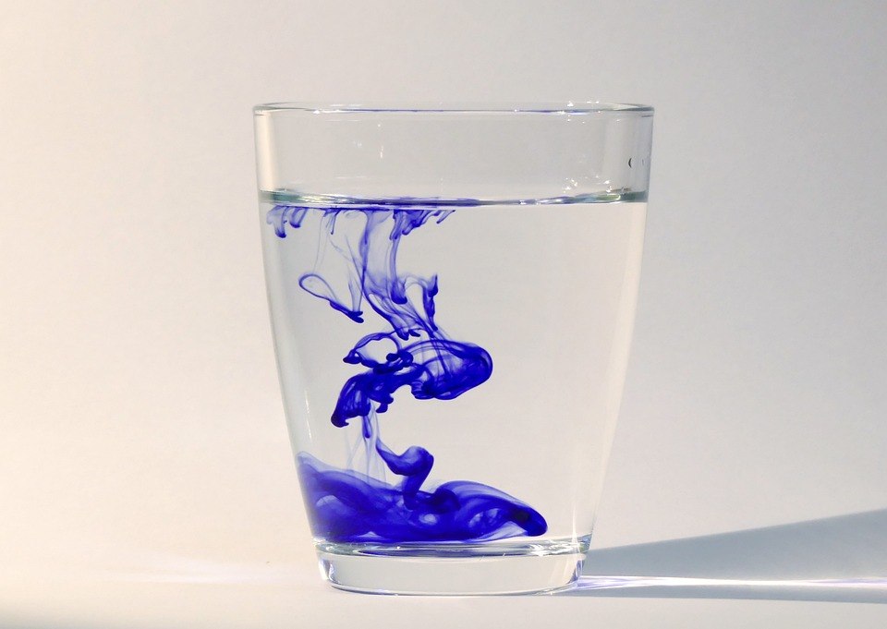
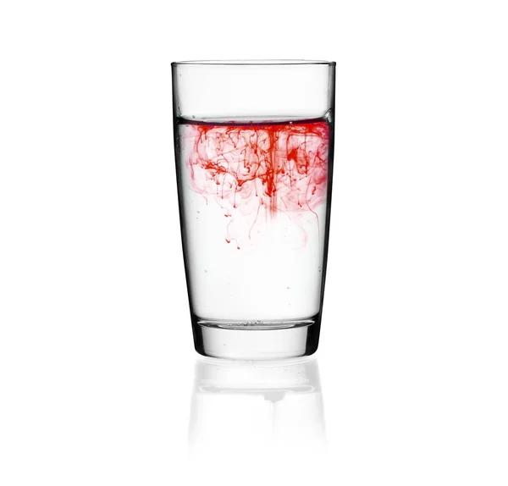
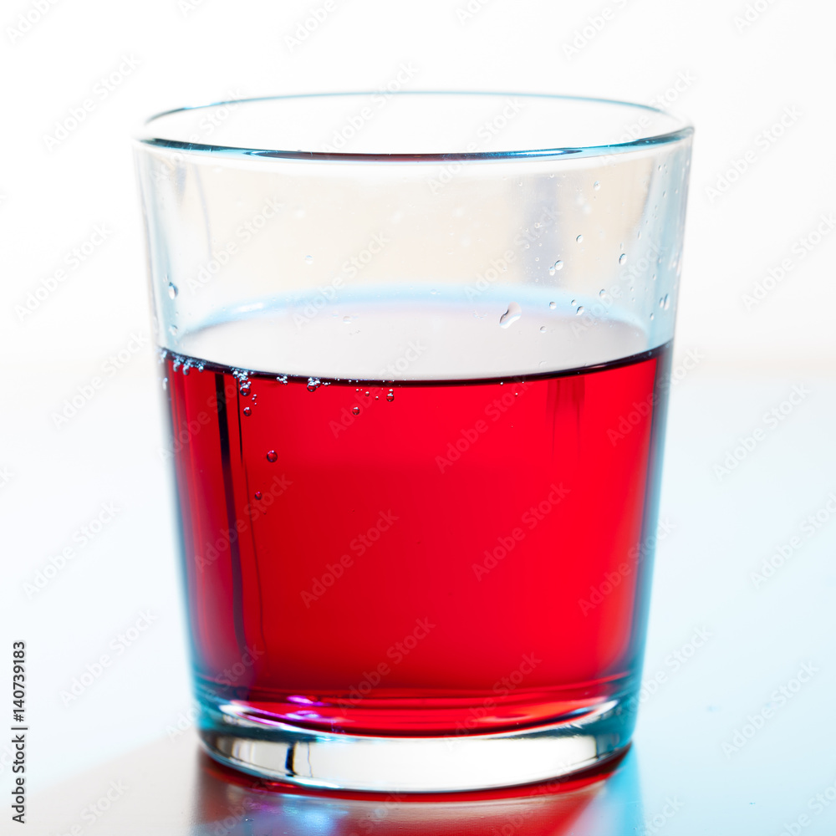
Intuition: Thermodynamics
If I learn the diffusion process …
Can I reverse the diffusion process and get back?

Slide 13
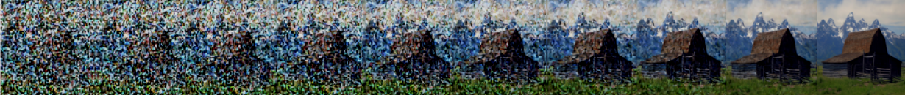
Intuition: Destroying structure in images
Destroy perceptual
details in early stages
Destroy semantics
In later stages

Slide 14
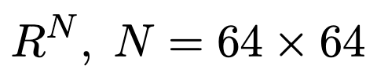

Slide 15
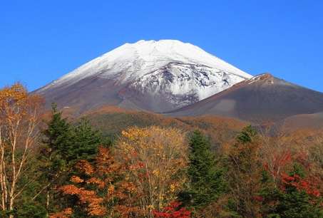

Slide 16

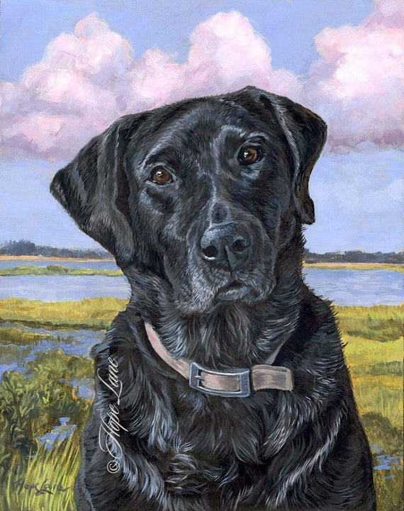

Slide 18
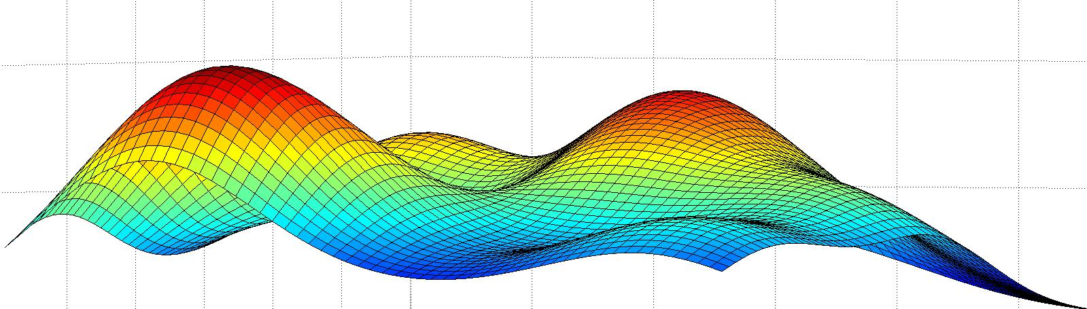

Slide 20
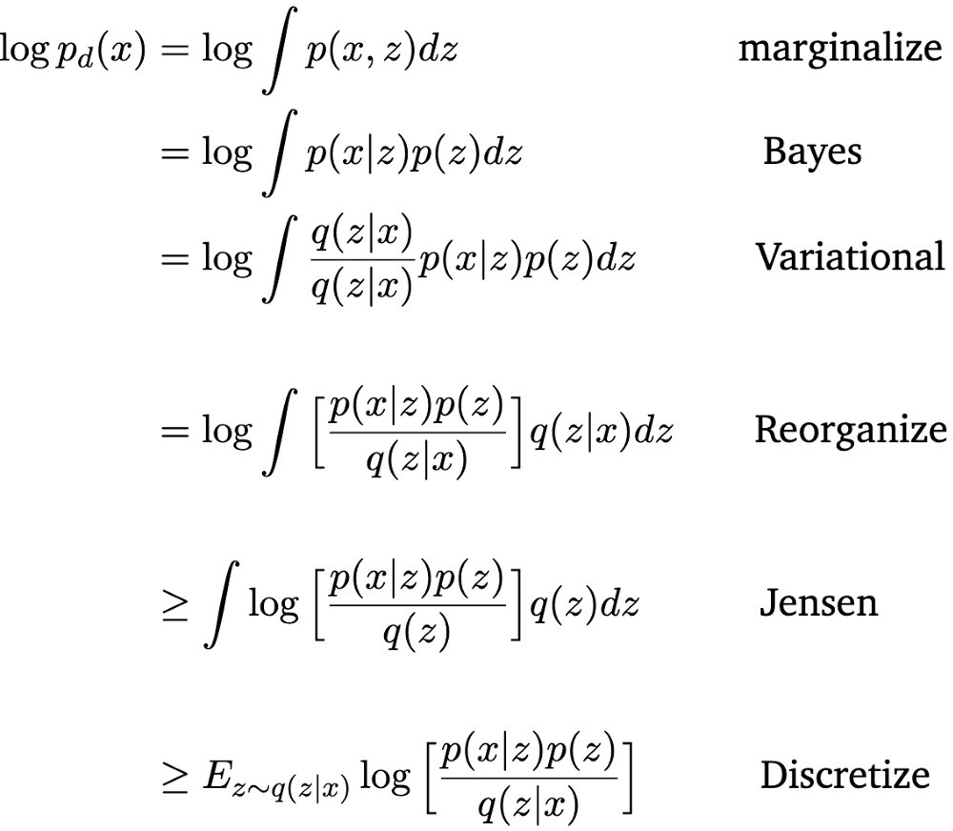
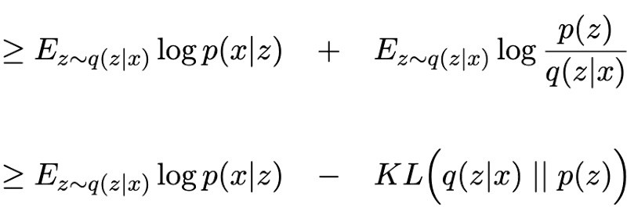
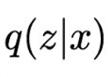
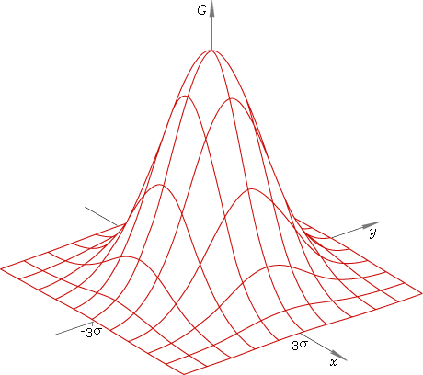
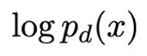
Any recollection of ELBO?
Can we recall in plain English?
Importance
sampling from
posterior
Encoder
Decoder
Evidence Lower Bound (ELBO)
Z space

Slide 21
Variational Diffusion Models (VDM):
Can we derive the (more complicated) ELBO for this VDM?

Slide 22
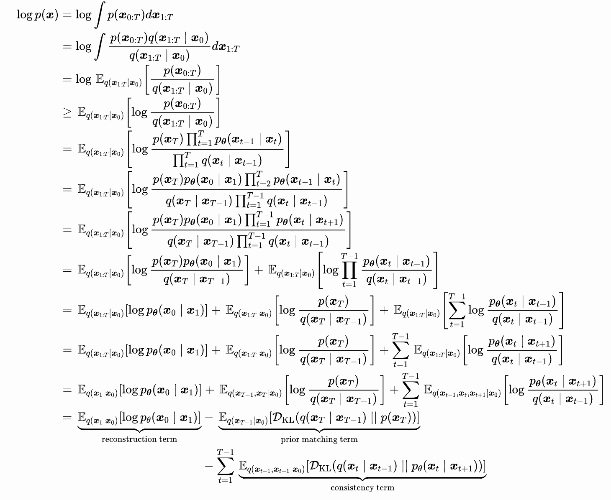
Variational Diffusion Models (VDM):
Yes, we can! Here’s the VDM ELBO:

Slide 23
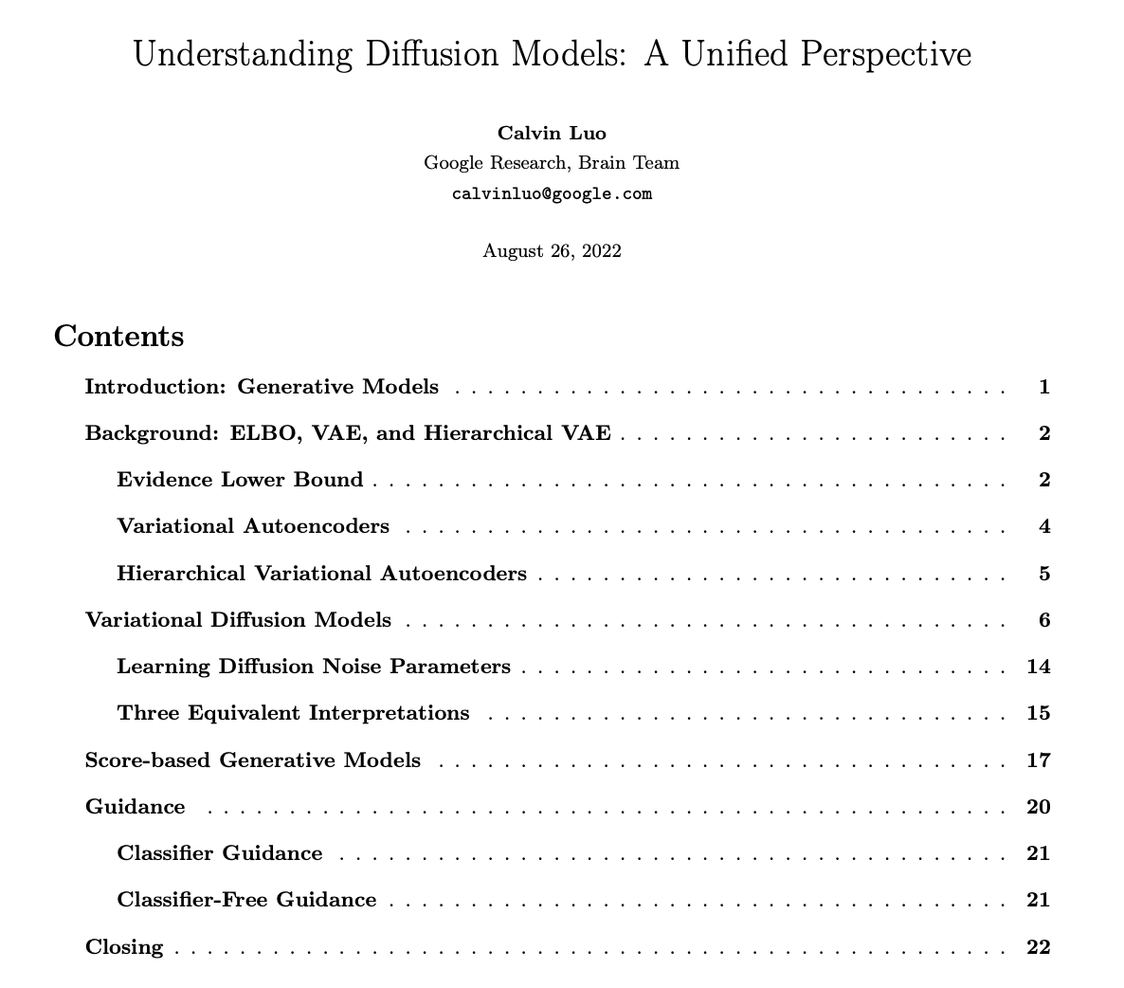
Variational Diffusion Models (VDM):
Yes, we can! Here’s the VDM ELBO:
This is not difficult ...
We just need to start
slow and small

Slide 24
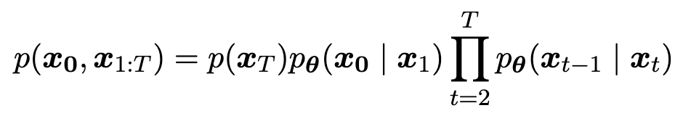
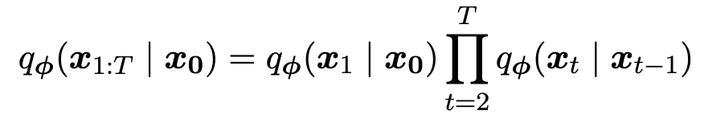
Markov Chain
Markov Decoders
Markov Encoders

Slide 25
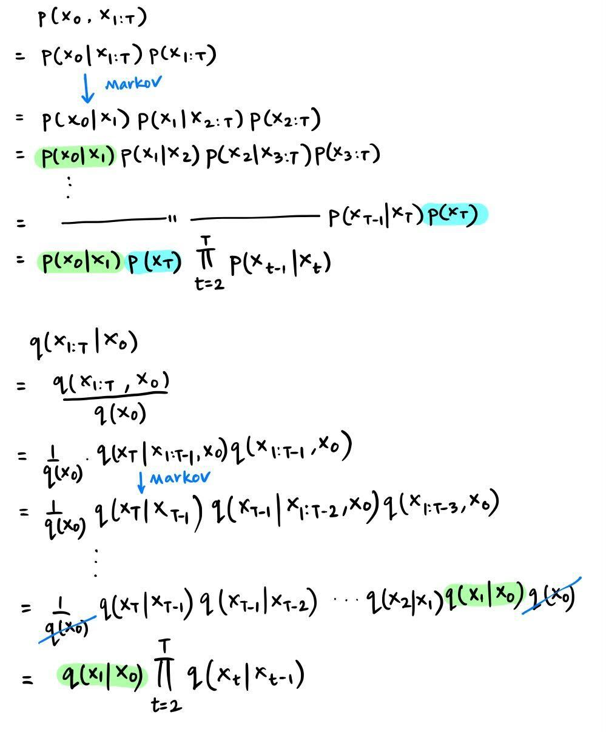
Hierarchical VAE
Markov Decoders
Markov Encoders

Slide 26
Variational Diffusion Models (VDM):
Yes, we can! Here’s the VDM ELBO:

Slide 27
Variational Diffusion Models (VDM):

Slide 28
Variational Diffusion Models (VDM):

Slide 29
Yes, we can! Here’s the VDM ELBO:

Slide 30
Yes, we can! Here’s the VDM ELBO:
Q: What is each encoder transition doing?
A:

Slide 31
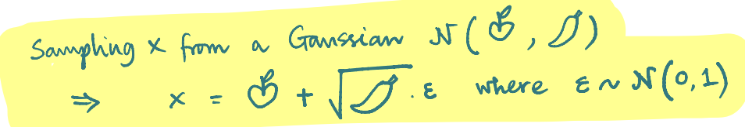
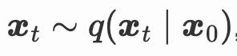
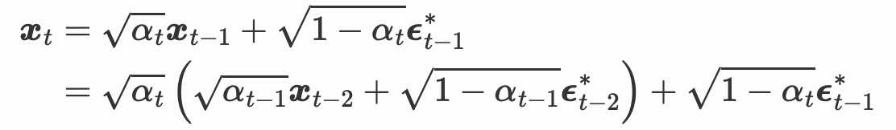
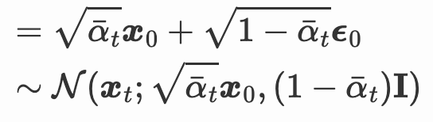
Yes, we can! Here’s the VDM ELBO:
Q: What is
A:
Q: What is each encoder transition doing?
A:

Slide 32
Yes, we can! Here’s the VDM ELBO:
Q: What is
A:
Q: What is each encoder transition doing?
A:
Sum of Gaussians

Slide 33
Yes, we can! Here’s the VDM ELBO:
Q: What is
A:
Q: What is each encoder transition doing?
A:
Sum of Gaussians
Why are we excited
That this is a Gaussian?

Slide 34
Yes, we can! Here’s the VDM ELBO:
Undesirable

Slide 35
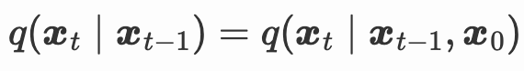
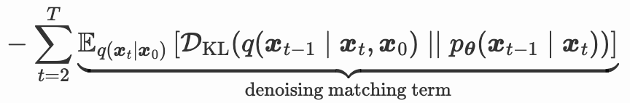
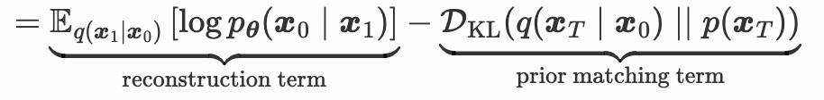
Yes, we can! Here’s the VDM ELBO:
Undesirable
→ Superfluous (due to Markov)
Re-derive ELBO

Slide 36
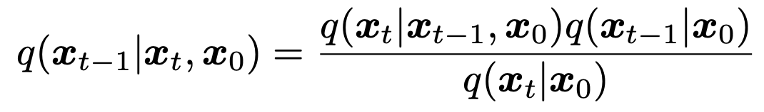
Yes, we can! Here’s the VDM ELBO:
Wait, how do we get:

Slide 37
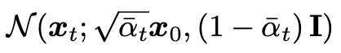
Yes, we can! Here’s the VDM ELBO:

Slide 38
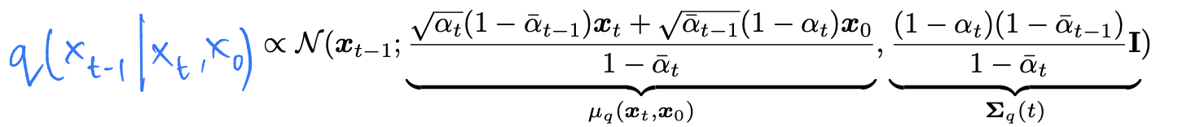
Yes, we can! Here’s the VDM ELBO:
Cleverly massaging
product of Gaussians

Slide 39
Yes, we can! Here’s the VDM ELBO:
Cleverly massaging
product of Gaussians

Slide 40
Yes, we can! Here’s the VDM ELBO:

Slide 41
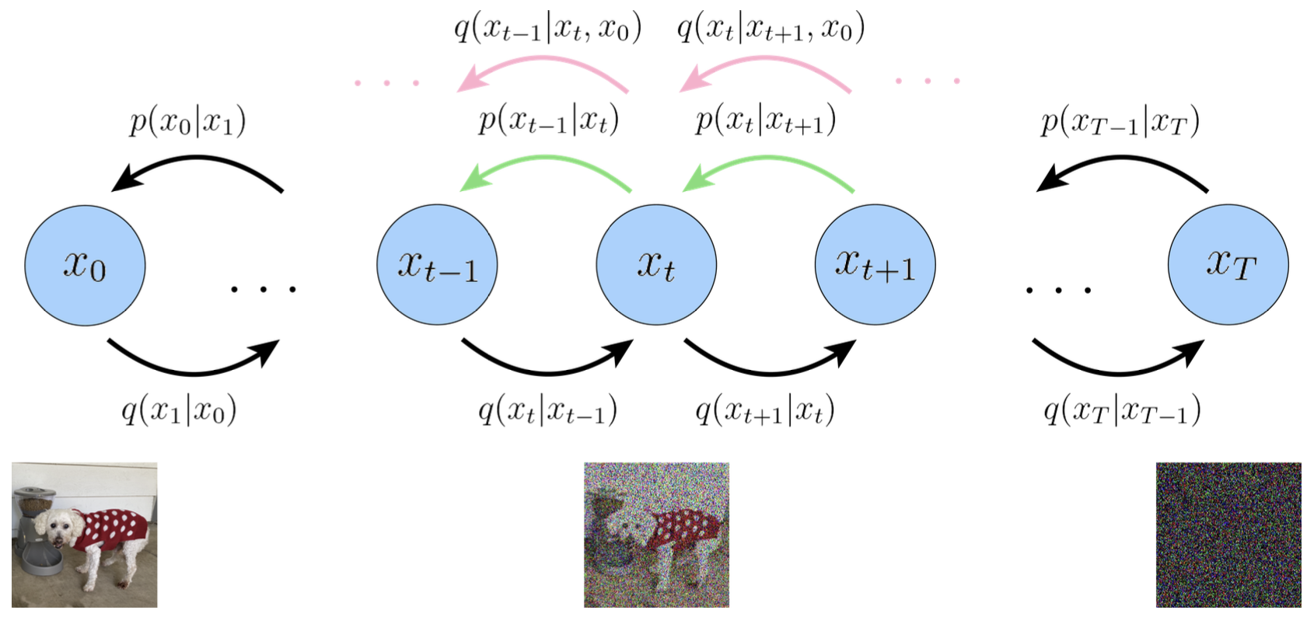
Yes, we can! Here’s the VDM ELBO:
KL between two Gaussians

Slide 42
Yes, we can! Here’s the VDM ELBO:
KL between two Gaussians
Do we need to learn both
mean and variance for the
Denoiser distribution?

Slide 43
Yes, we can! Here’s the VDM ELBO:
KL between two Gaussians
Do we need to learn both
mean and variance for the
Denoiser distribution?
Recall
from few slides back

Slide 44
Yes, we can! Here’s the VDM ELBO:
KL between two Gaussians
Do we need to learn both
mean and variance for the
Denoiser distribution?
Recall
from few slides back
Variance is known for time t.
Only need to learn mean.

Slide 45
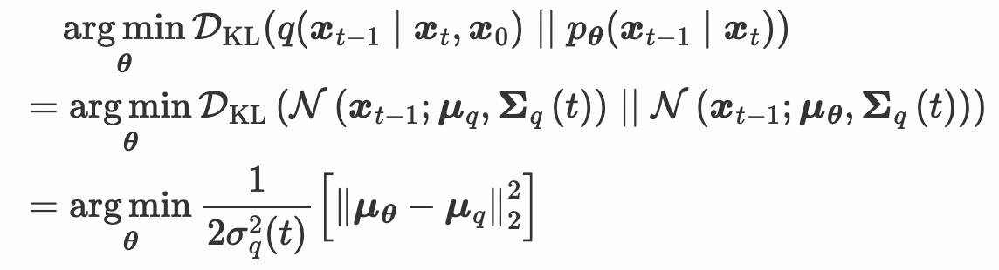
Yes, we can! Here’s the VDM ELBO:
KL between two Gaussians
Can we expand these two means?

Slide 46
Yes, we can! Here’s the VDM ELBO:
Can we expand these two means?

Slide 47

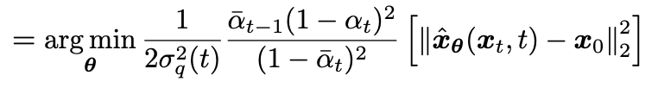
Yes, we can! Here’s the VDM ELBO:
Can we expand these two means?

Slide 48
Let’s zoom out

Slide 50
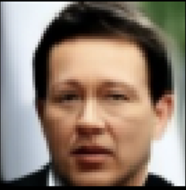
Training

Slide 51
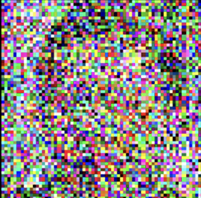
Training

Slide 52
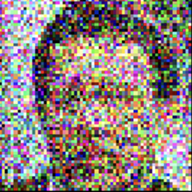

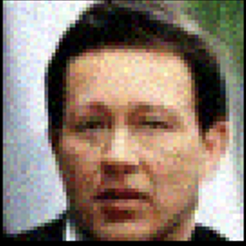
Training
…

Slide 53
Training
…

Slide 54
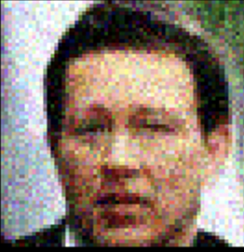
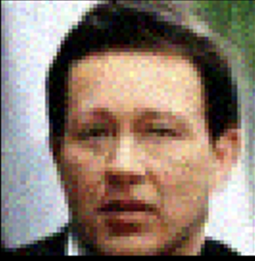

Inference 1
…

Slide 55
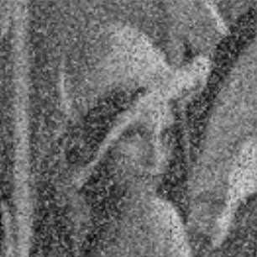







Inference 2
…

Slide 56

Dejavu
I can start at a random point in image space and use score to ascend → I have real image samples
Many paths of approach:
Thermodynamics (destroying structure and repairing)
Stochastic Diff. Equations (destroying process is a solution to a SDE)
Hierarchical VAE (each step is a latent representation)
Sampling from a complex density function

Slide 57
Questions

